Slide 1
Accessing the PowerShell Console and PowerShell ISE

Slide 2
In this Video, we are going to take a look at…
The PowerShell console
The elevated console
The x86 console
PowerShell ISE (Integrated Scripting Environment)

Slide 3

PowerShell Console
Usually used for live administrative tasks both local and remote

Slide 4

PowerShell ISE
The Integrated Scripting Environment allows for both immediate tasks and administration along with the ability to create scripts for the repetition or automation of tasks

Slide 5
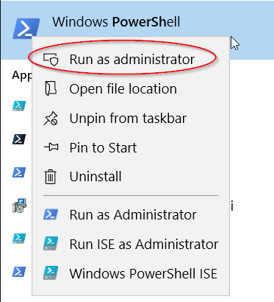
Administrator Console
To access the administrator console –
Locate the console application
Right click the application
Choose run as administrator

Slide 6
Accessing and Updating the Help System
Next Video

